Slide 1
VBA Lab PPT

Slide 2
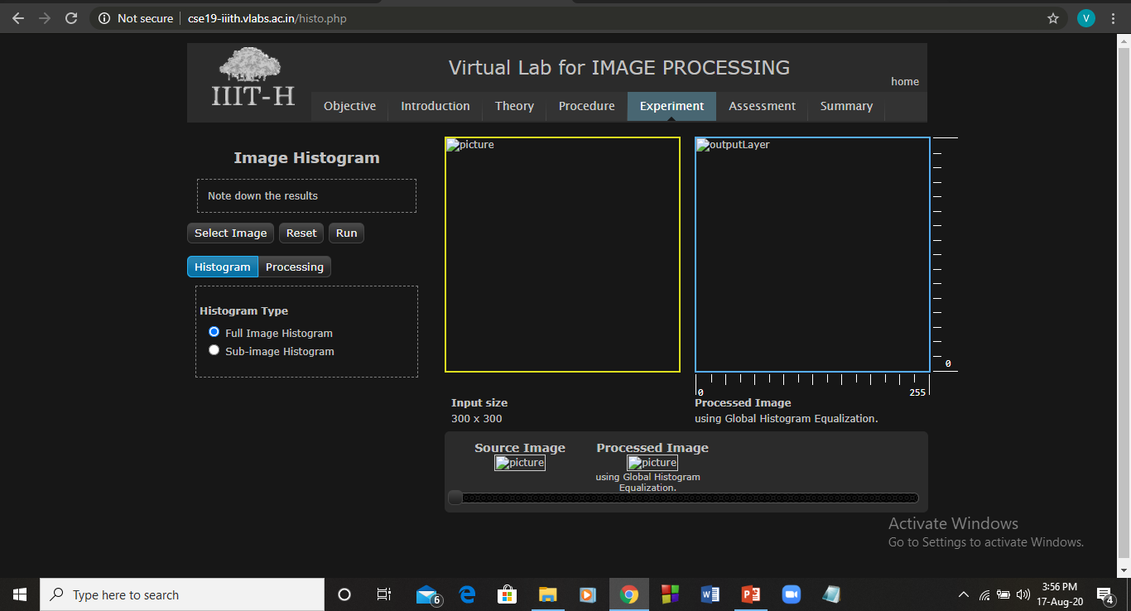
Lab 1 : Image Histogram Equalization

Slide 3
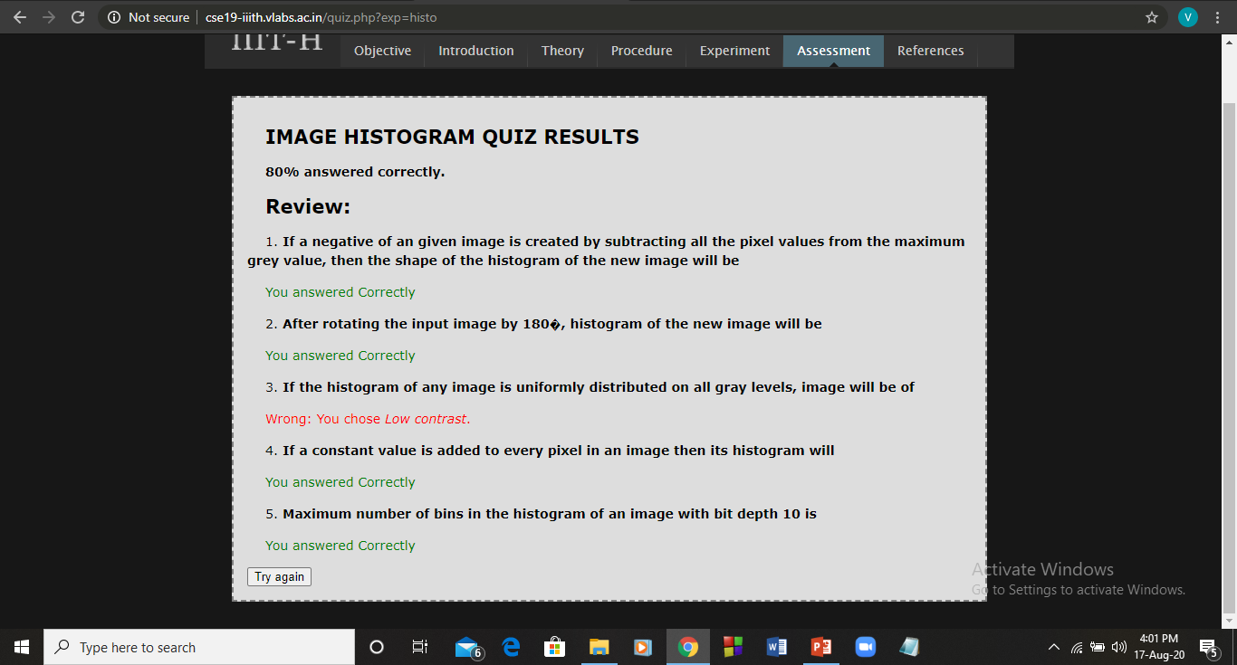
Quiz

Slide 4
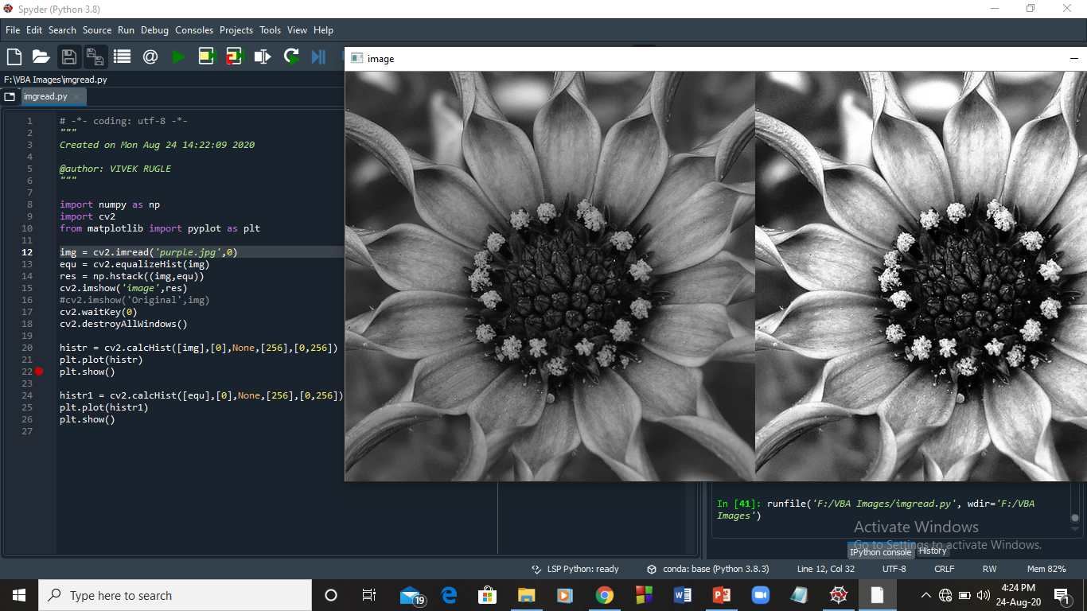
Lab 2 : Python code to read image and plot histogram

Slide 5
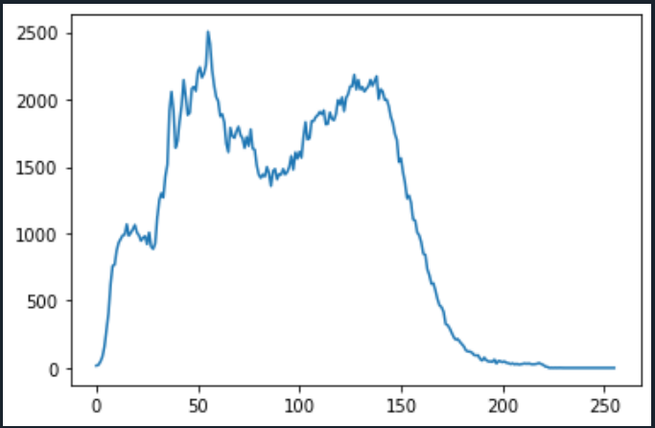
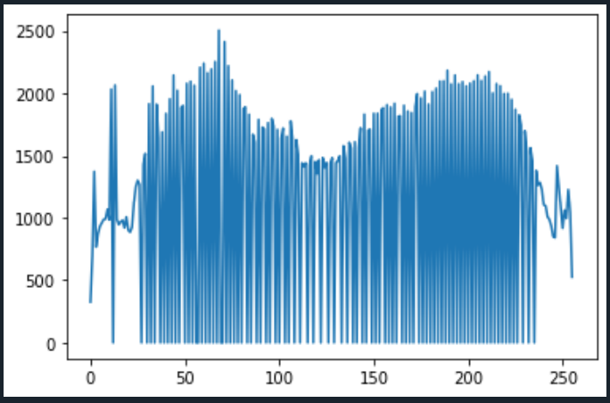
Histogram (original vs equalized)

Slide 6
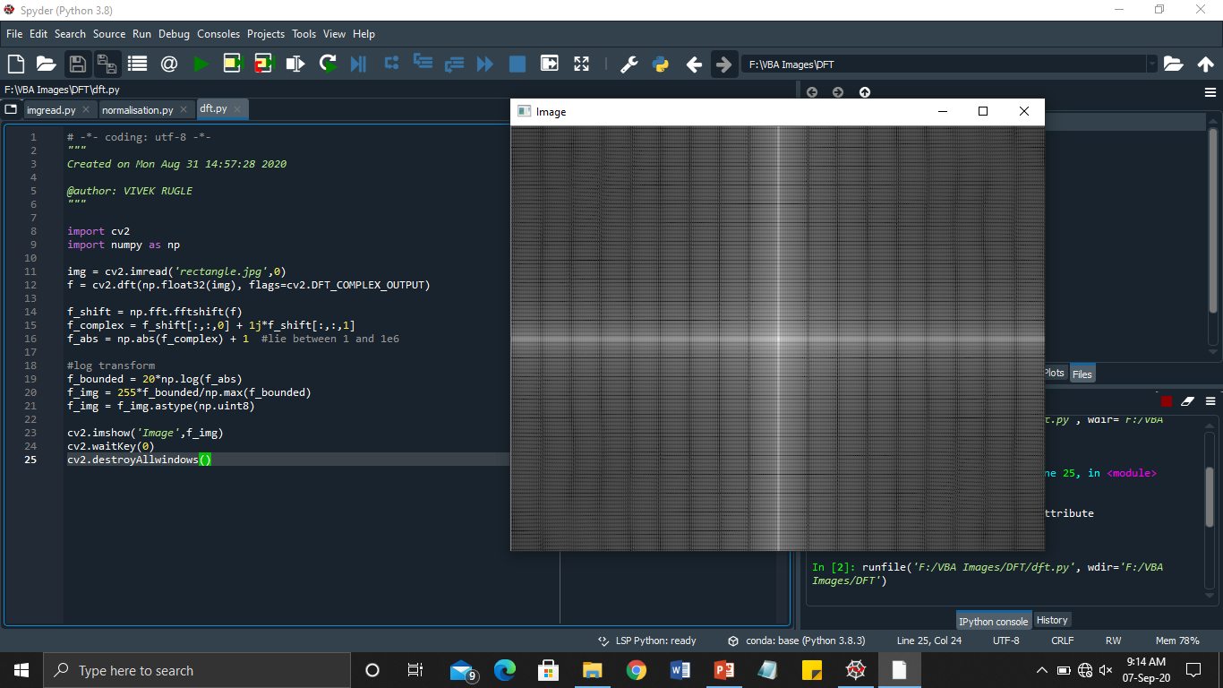

Lab 3: DFT of an image using open cv
DFT of rectangle image
Original Image

Slide 7
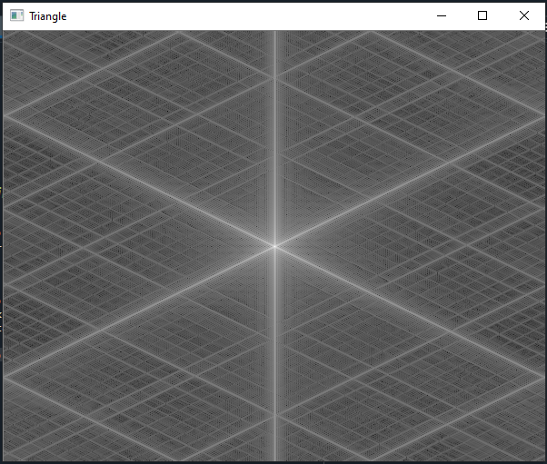
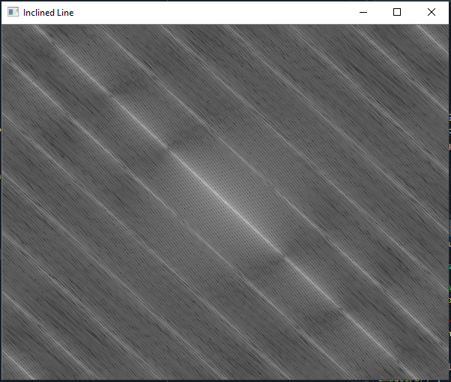
For triangle and inclined line -

Slide 8
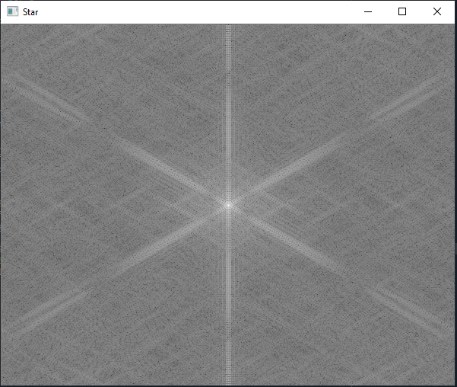
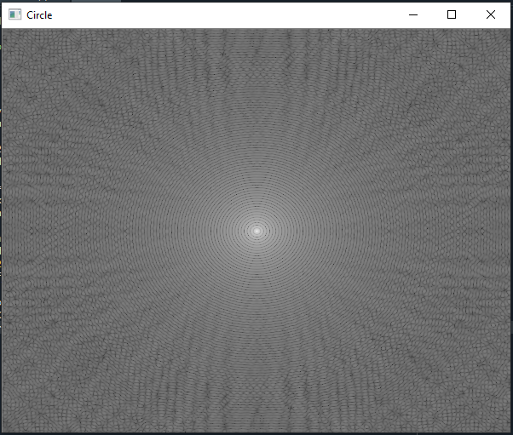
For star and circle -

Slide 9
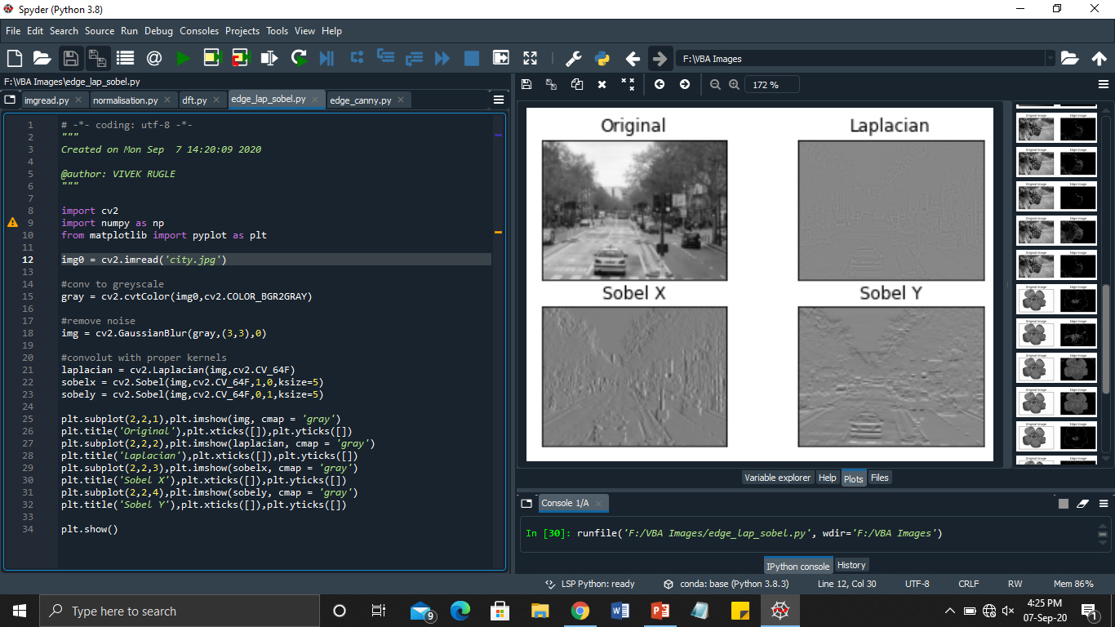
Lab 4: Edge detection using open cv
Using Sobel operator

Slide 10
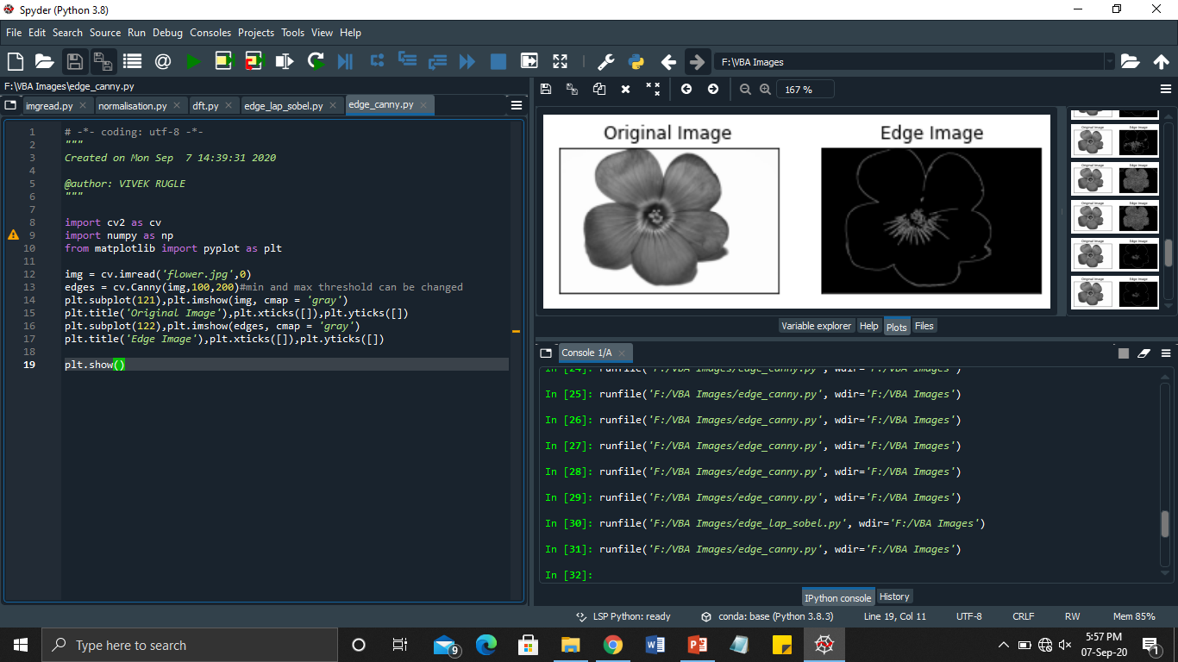
Canny edge detection

Slide 11
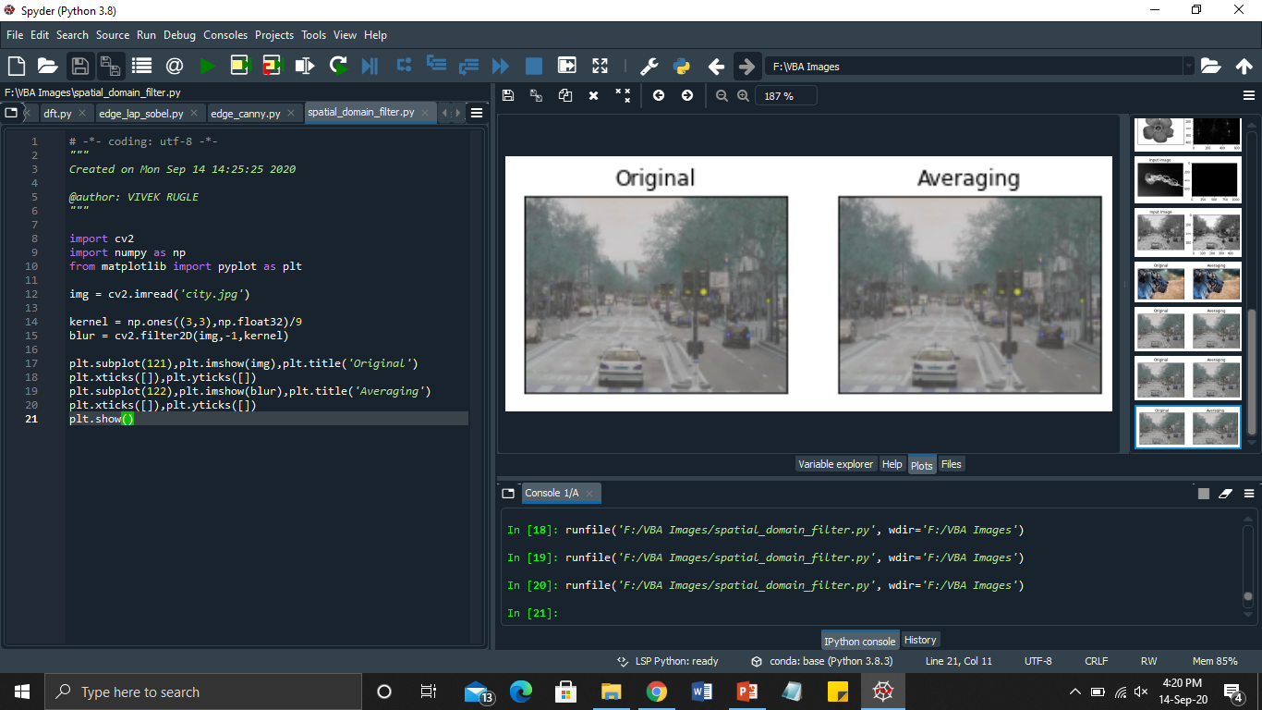
Lab 5: Low pass filtering of image
Spatial Domain

Slide 12
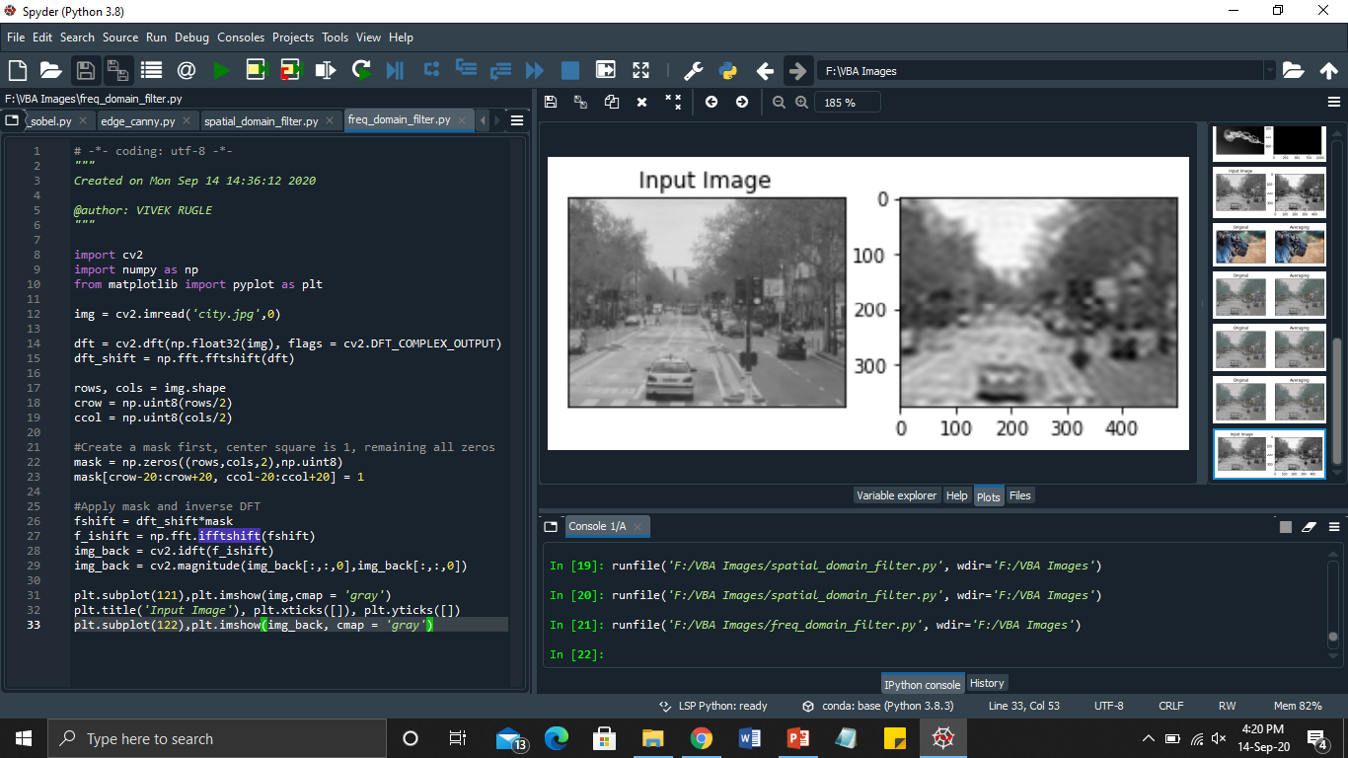
Frequency Domain

Slide 13
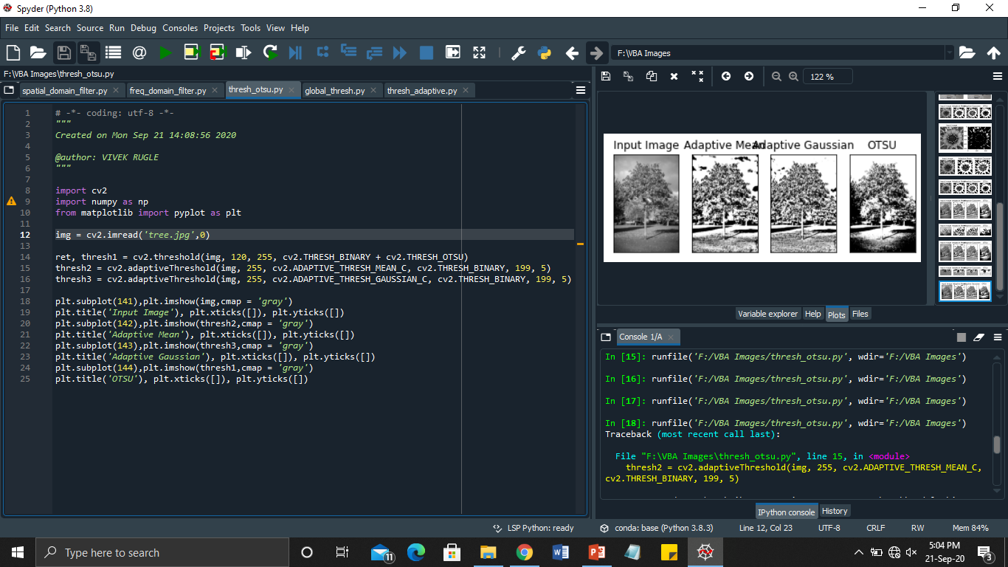
Lab 6: Image segmentation using opencv
Otsu Thresholding -

Slide 14
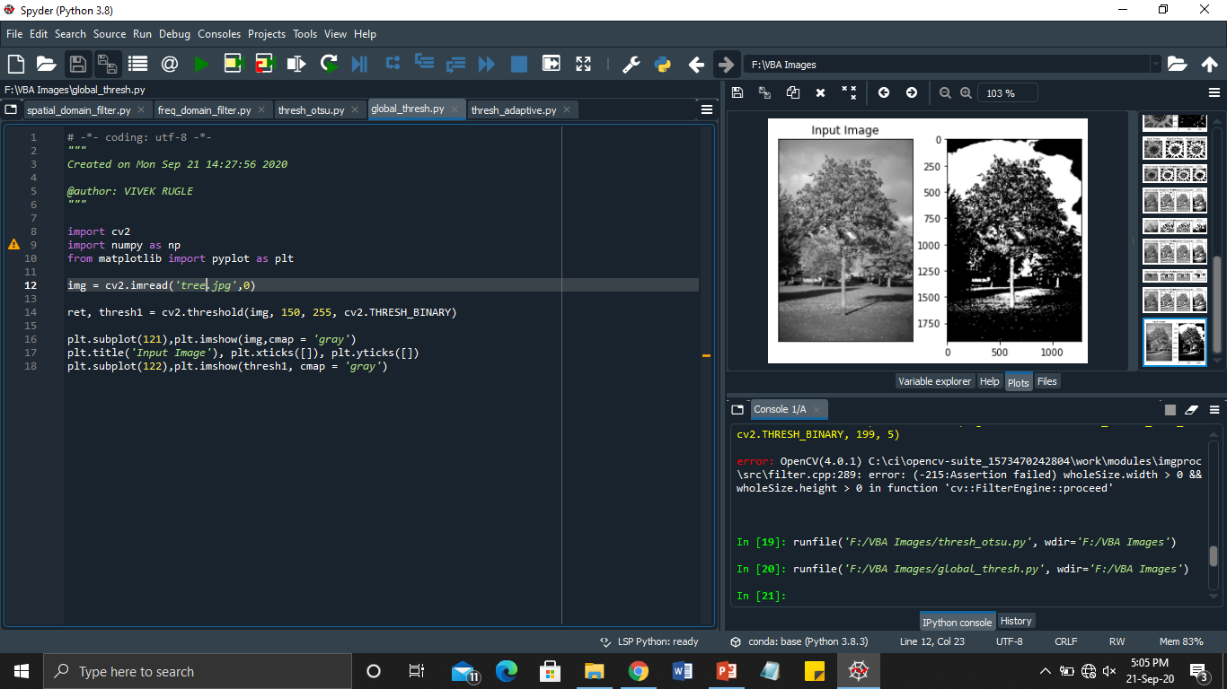
Global Thresholding

Slide 15
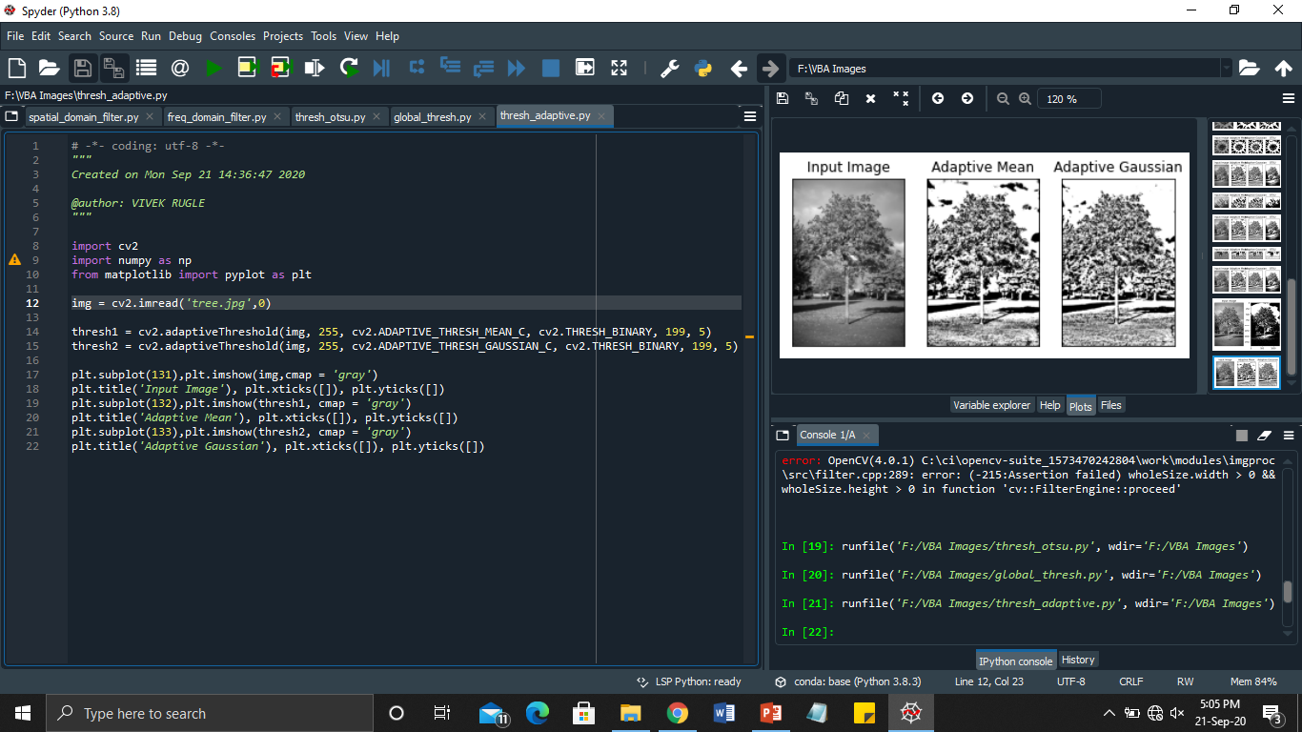
Adaptive Thresholding

Slide 16
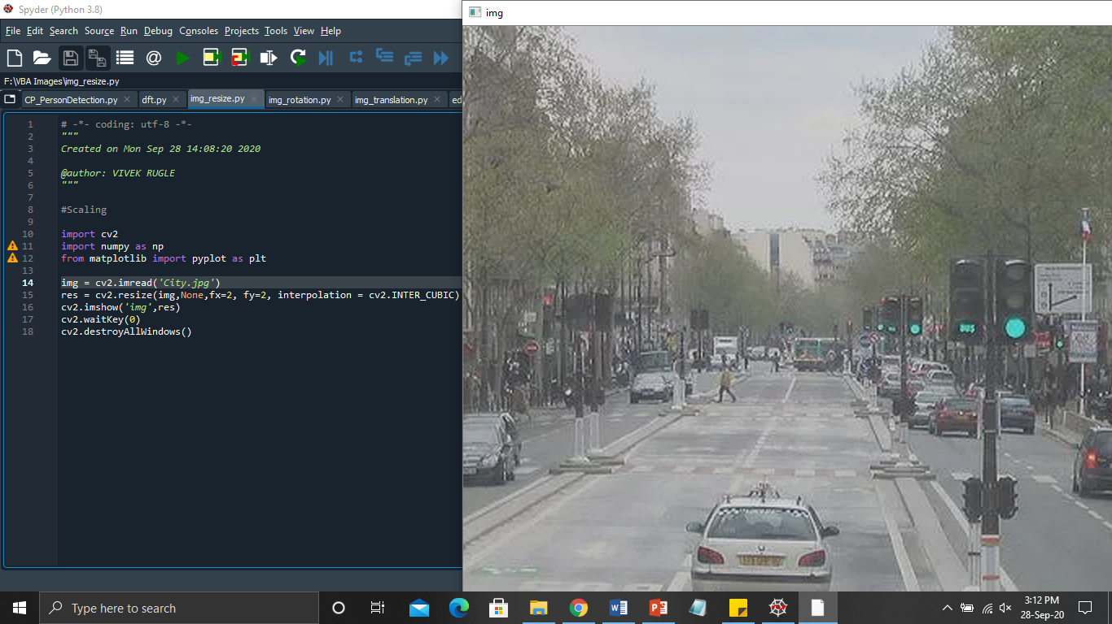
Lab 7: Scaling, rotation and translation of image using opencv
Scaling

Slide 17
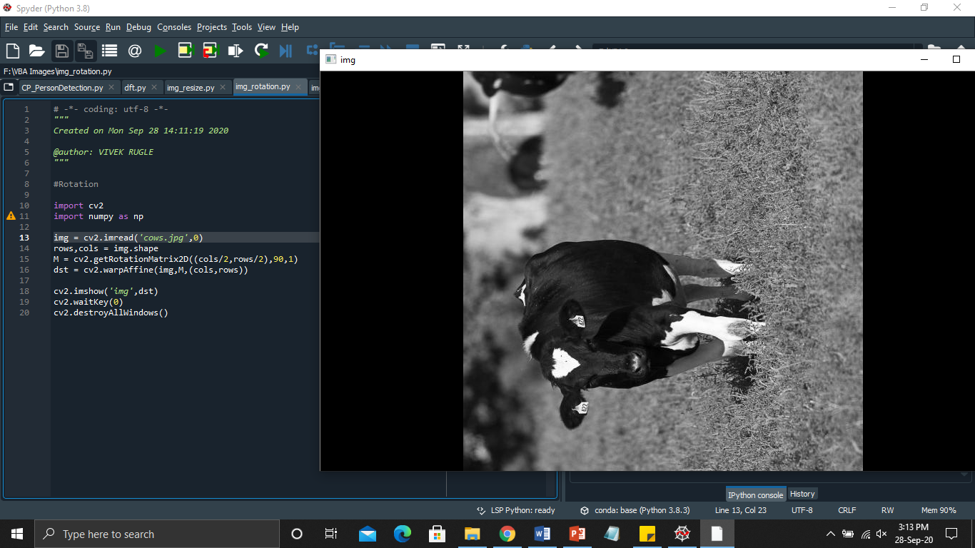
Image rotation

Slide 18
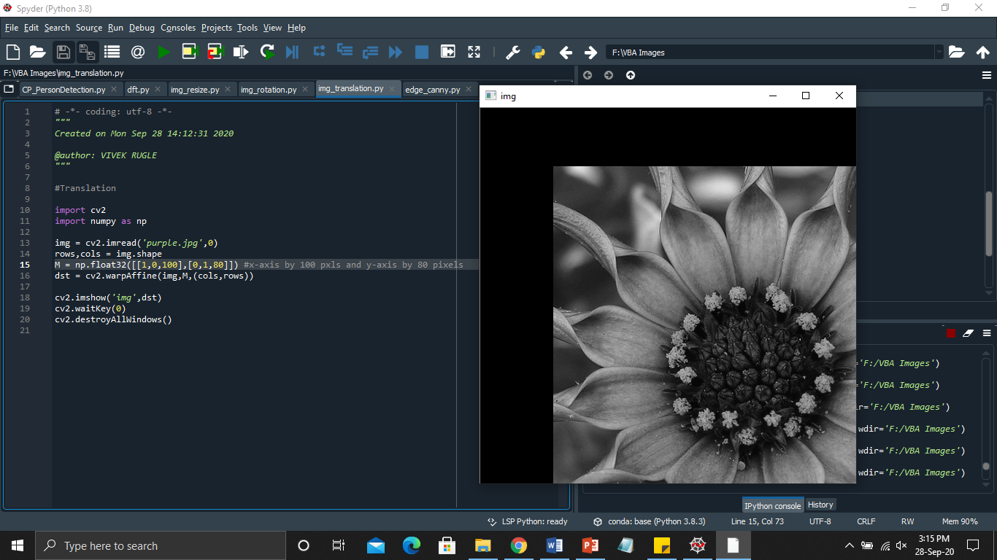
Image translation

Slide 19
Lab 8: Radon & Gabor Transformation

Slide 20
Lab 9: K-Means classifier on Iris dataset.

